Slide 1

Welcome to
4th Grade
Fiddyment Elementary
MRs. Benato

Slide 2

Agenda
Introduction
Policies & Procedures
School Supplies
Parent Volunteers
Announcements
My Contact Information
Class Website

Slide 3
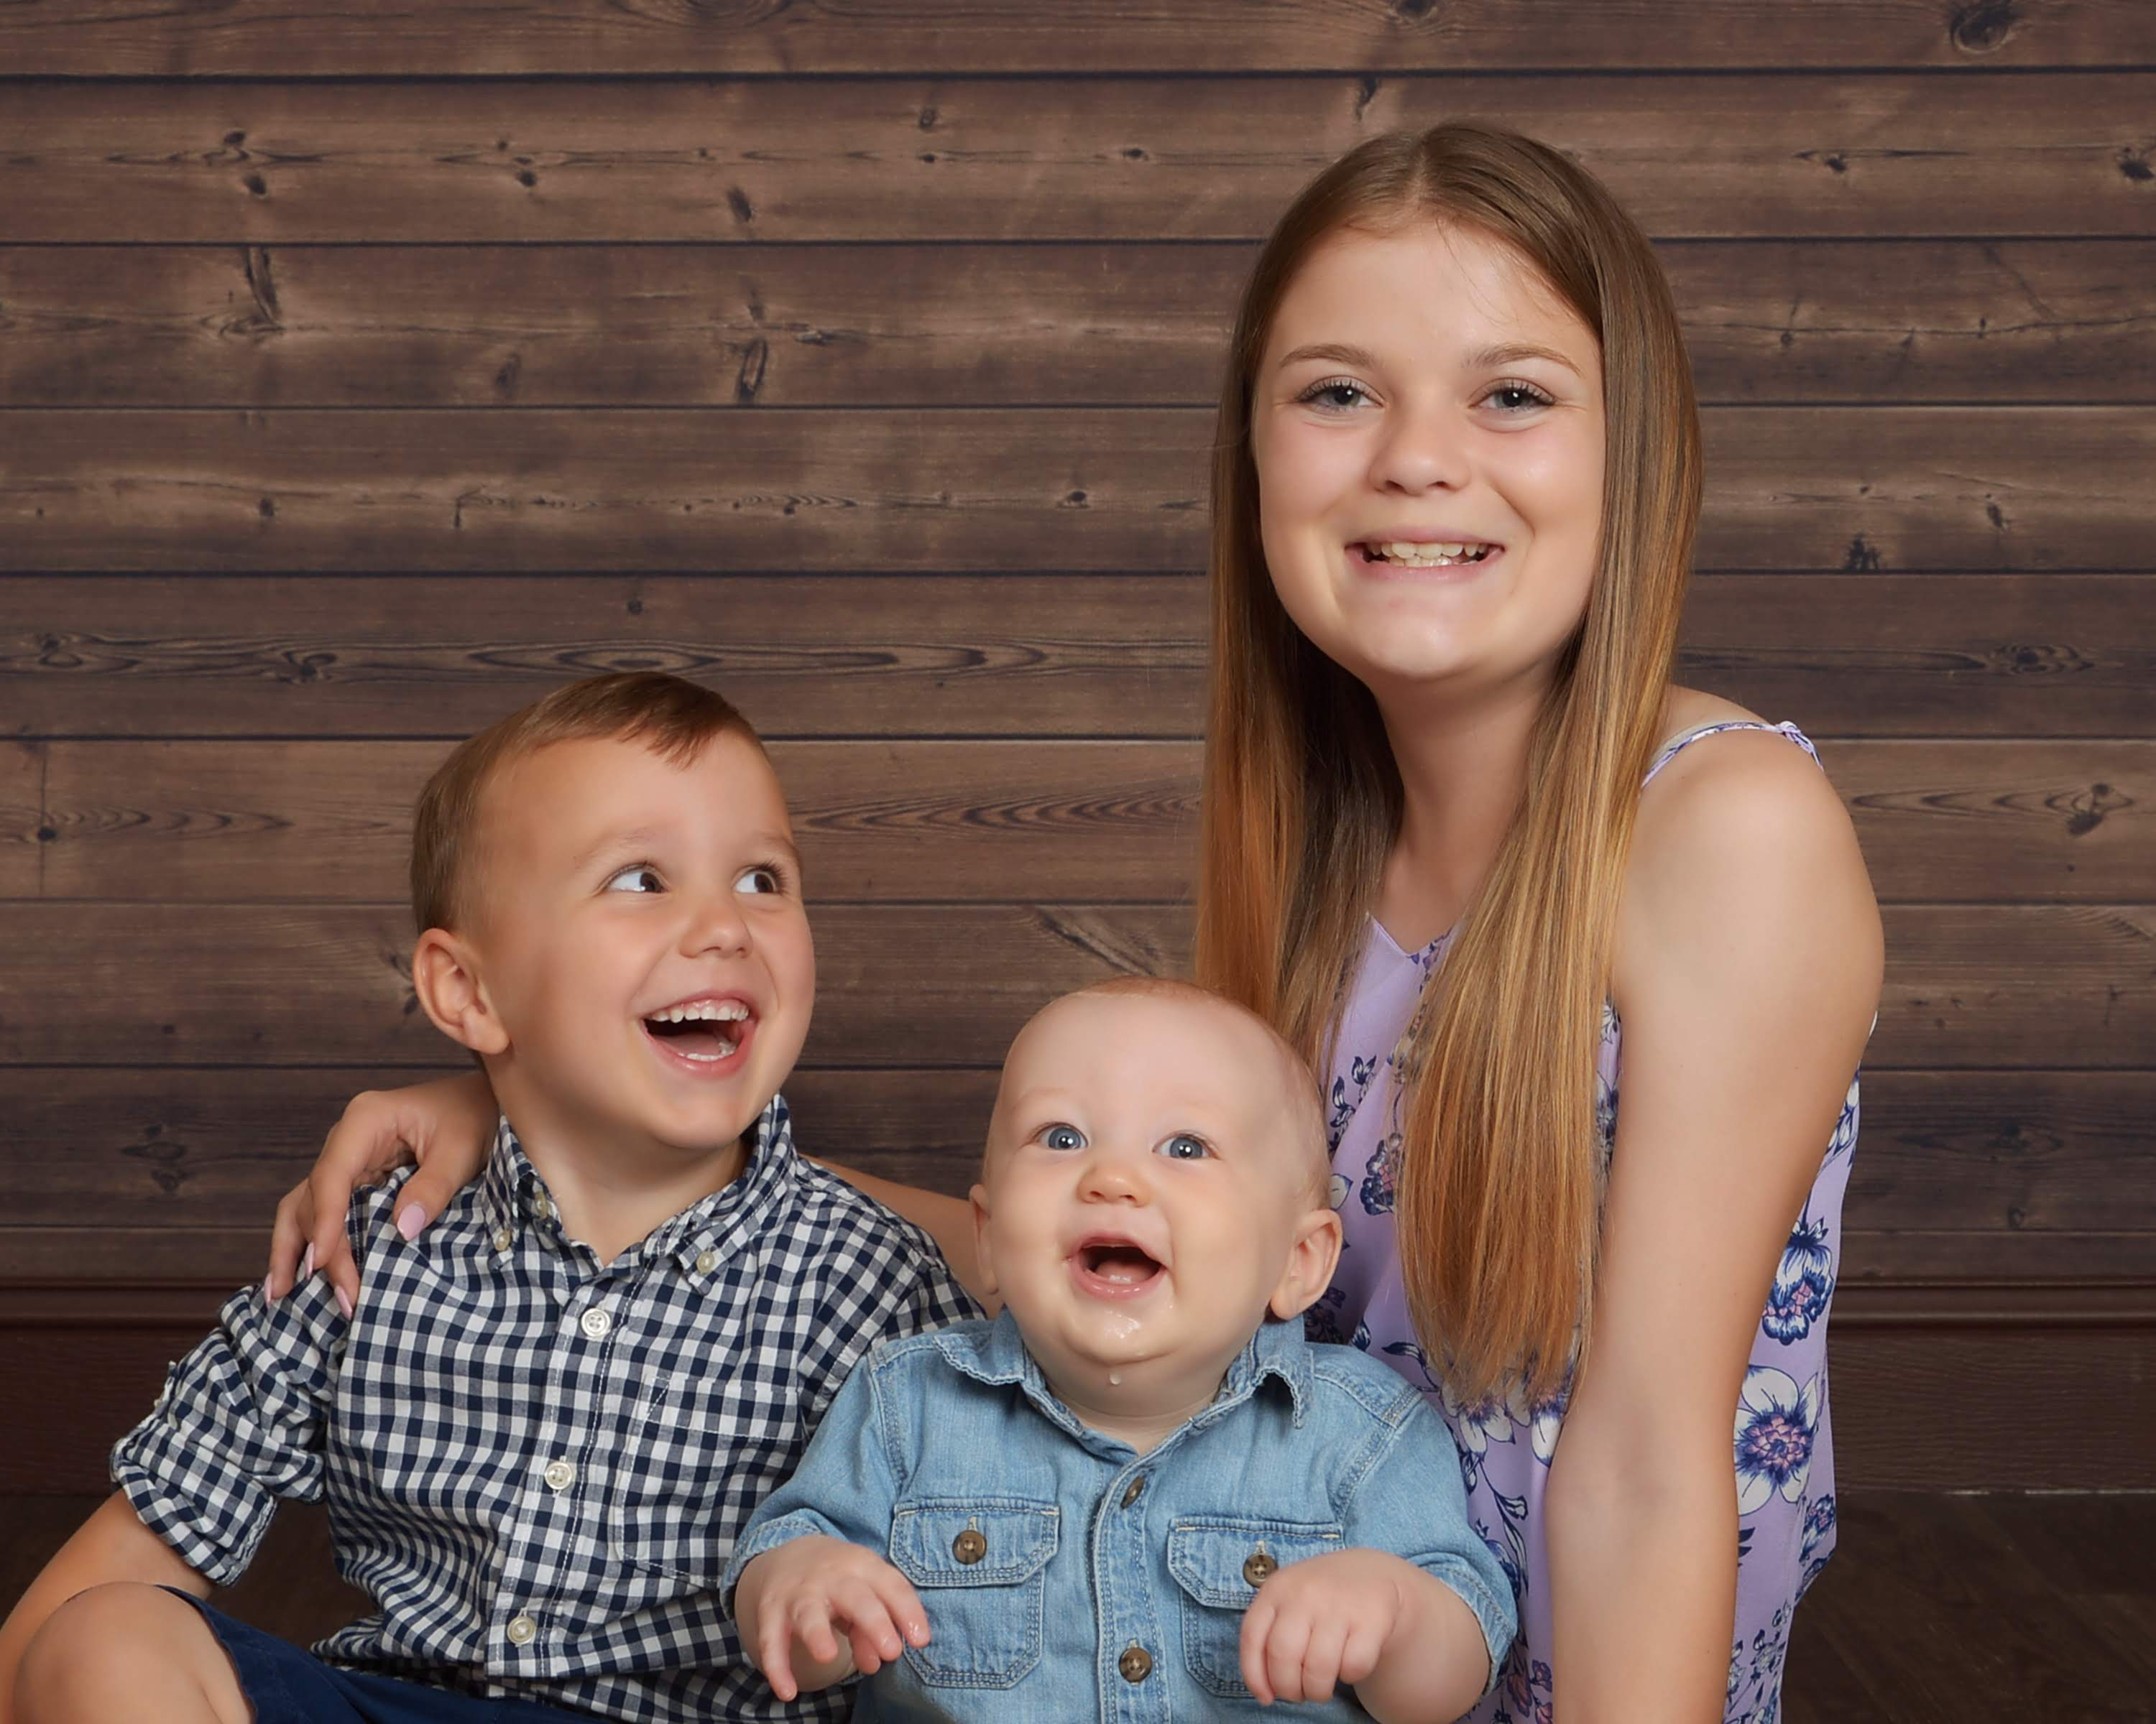
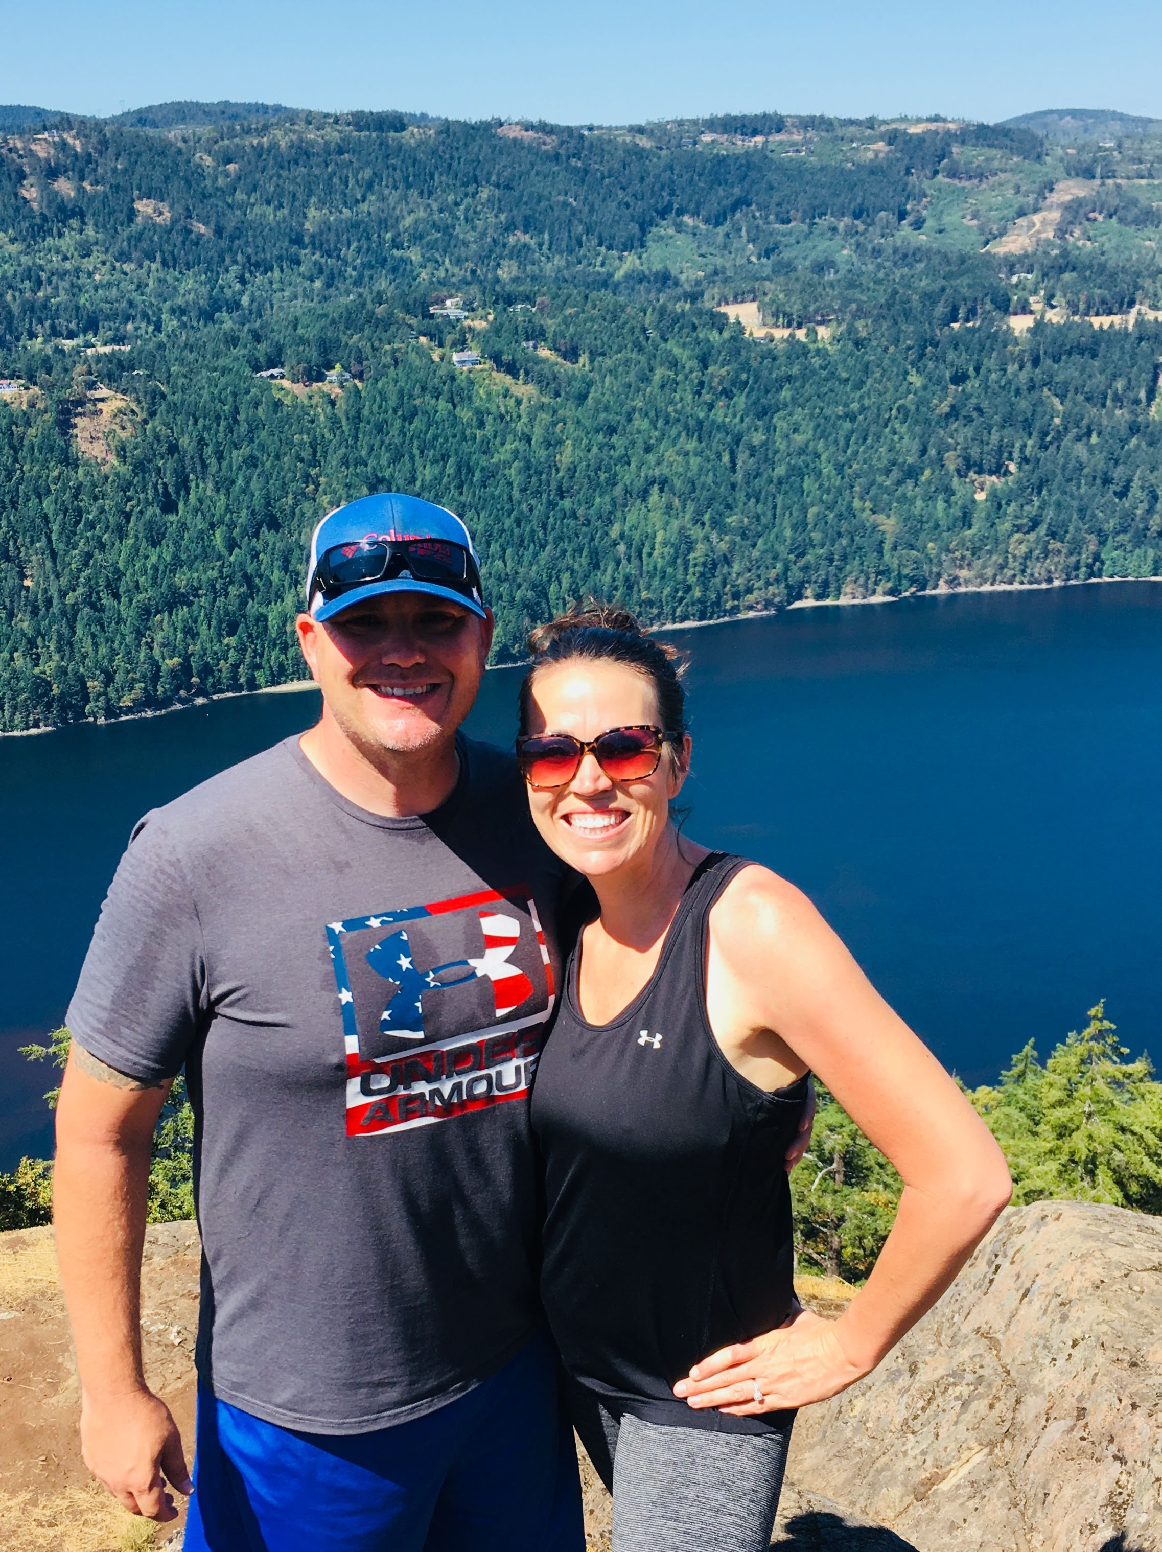
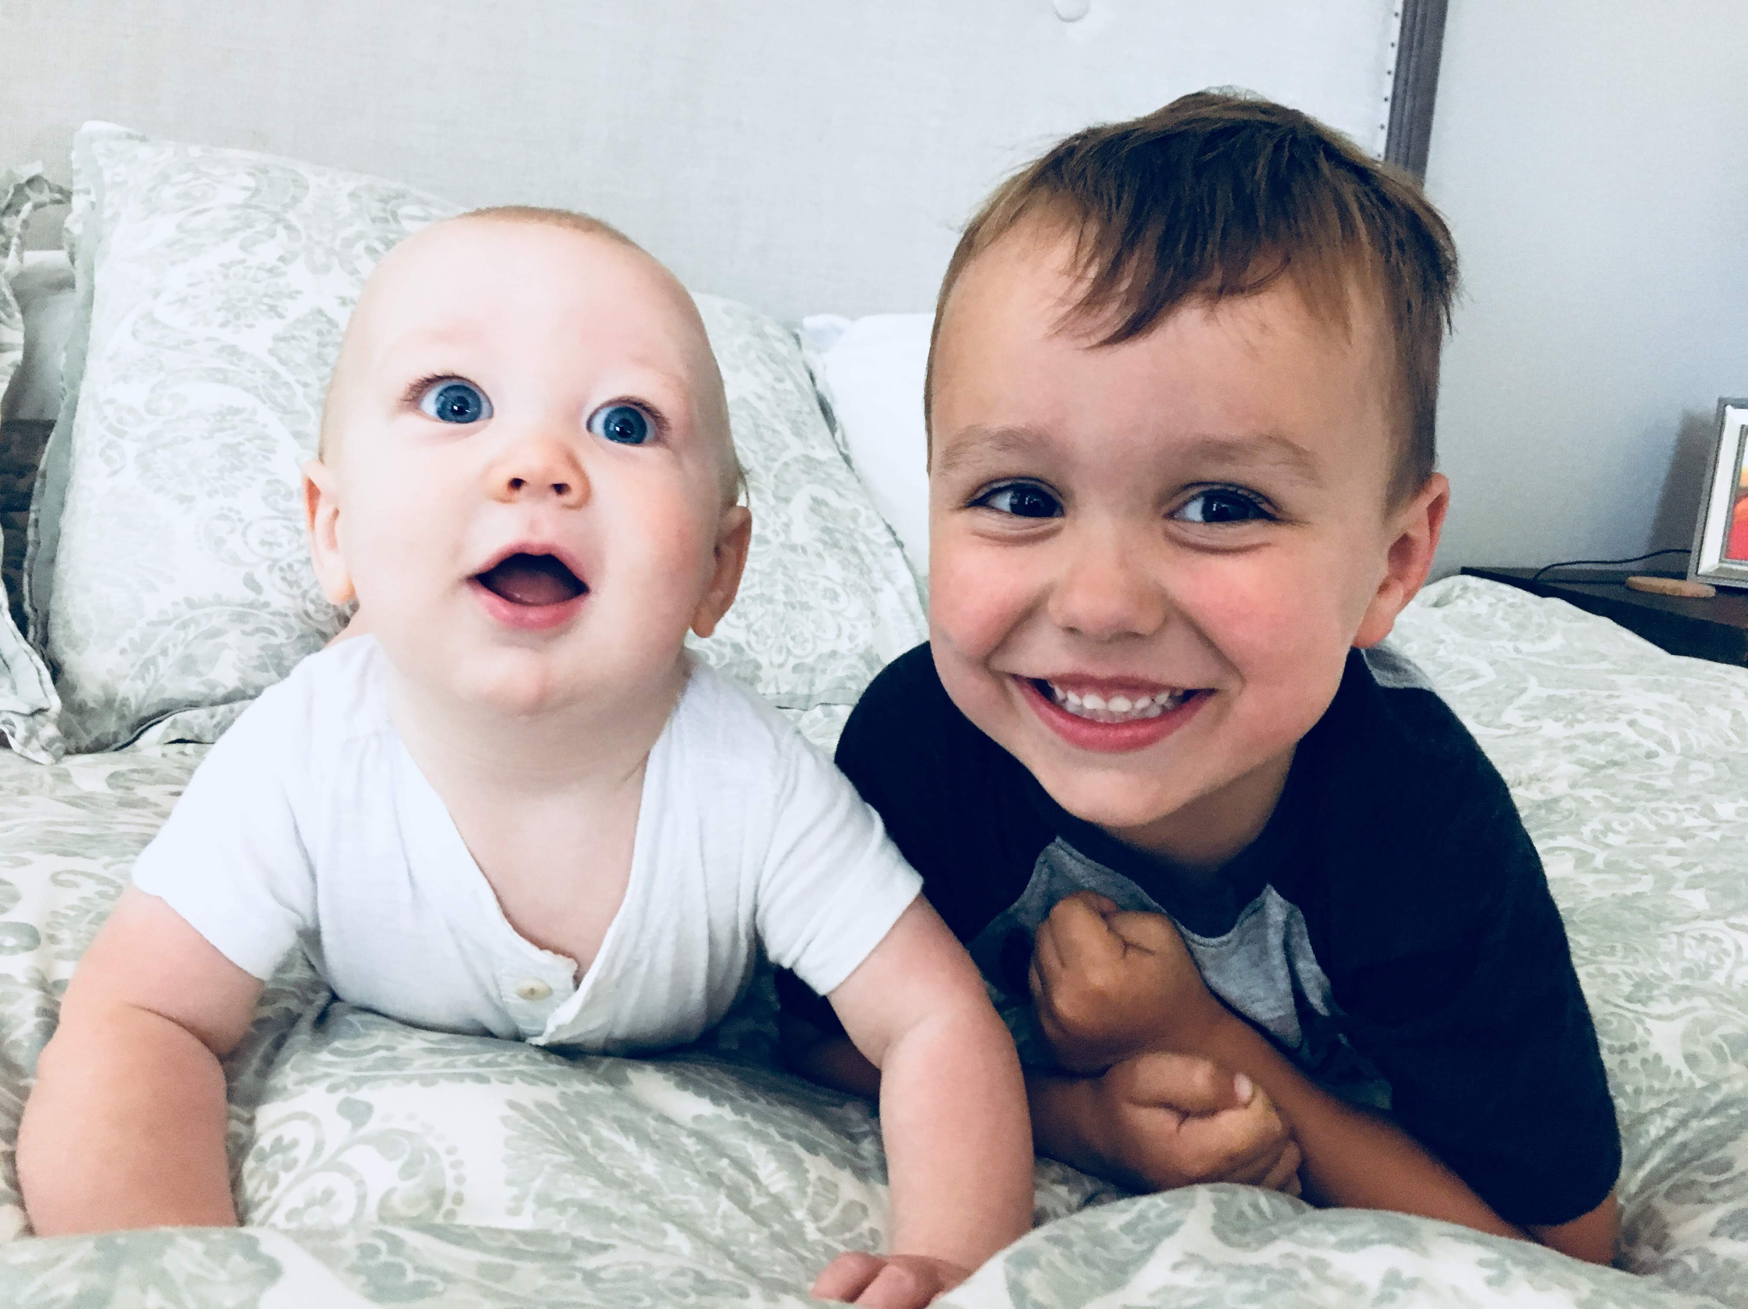
introduction
Hi,
I’m Mrs. Benato!
This is my 13th year teaching
Graduated From San Diego State University
Multiple Subject Teaching Credential From Sacramento State University
I’ve taught several grade levels
Great Team of Teachers to work with

Slide 4
Homework Policy
Any work sent home will serve as reinforcement to lessons presented in class. It will not be required.
Homework is a chance for students to practice what they learned. It should be completed independently (for the most part) and turned in when finished.
4th grade homework assignments should take about 1 hour. This may/may not include the 20min of reading.
Math homework assignments mirror the lesson each day & are due the following day.
Spelling/Vocab list will be given on Mondays & completed assignments will be collected on Fridays.
There will be NO homework on weekends…

Slide 6

30 Book Challenge:
*As part of your child’s Language Arts curriculum this year, your child will be participating in a 30 book challenge!
* Students should plan to read about 10 chapter books a trimester. They will earn credit in class by writing a summary, doing a “Book Talk”, posting a blog on our class website etc.
*Some of the reading will be done in class, however students are expected to be reading at home (about 15-25 minutes nightly).
My goal for the program is to have my students not only leave 4th grade with foundational skills for reading and reading strategies, I want my students to LOVE to read! Please visit the website for the genre requirements.

Slide 7

4th Grade Presentations:
As part of our 4th grade Common Core Curriculum for Listening and Speaking, students will be orally presenting poetry and projects throughout the year.
Poetry Presentations:
*A list of poetry options will provided at the beginning of each month.
*Students will memorize and recite a poem weekly, beginning in September.
Reader’s Theater: End of each ELA unit
Trimester Projects: CA Regions, California Natives, Missions, etc.

Slide 8
Fun Friday & homework hall
Fun Friday:
        Students who have completed all class work and homework earn time for art projects, science experiments, math games, and other fun activities on Friday afternoons!
“Finish-Up” Friday:
      Students who are missing assignments will go to another classroom to complete their work.

Slide 9
Absences & make-up work
If your child is absent, you are welcome to pick up missed assignments at the END of the school day. This will ensure that your child has all of the needed materials, notes, and handouts in order to complete the missed lessons. Please send me an email if you plan to pick it up.
It is the student’s responsibility to make sure that all the missing assignments have been turned in.
Office Notes :
Missing 5+ days of school is handled differently Your child can be put on an independent study contract. If your child will be out for an extended period of time, please contact me 2 weeks prior to their absences.

Slide 10

Friday Papers
All papers are sent home with students on Friday in their homework folder. This includes important notes and announcements from the office or myself as well as student work.
Please ask your child to share what
is in their folders on Friday!
Our home-school communication is emailed out on Fridays. Please check your email for “Friday News” ☺

Slide 11
Our Week at a glance
Monday – Music @ 11:50am
Tuesday – Library @ 9:20am
Wednesday – PE @ 8:50am
Thursday – PE @ 11:00am
Friday –Little Buddies/ SING
*Please remind your child
to wear tennis shoes on PE days! ☺

Slide 12
Field trips
Our field trips in 4th grade will include:
1st Trimester:
California State Capital
2nd Trimester:
Roseville Utility Exploration Center
3rd Trimester:
James Marshall Discovery Gold Park
Please Note:
Chaperone’s will be chosen on a first-come-first-serve basis. However, if you have attended one field trip, then I would like to give another parent a chance to attend. Category II clearance is needed for field trip chaperones

Slide 13

Behavior policy
The best learning environment is safe, engaging, empowering, and positive.
        Great Tickets & Group Points
If all of my positive rewards are not successful, then consequences are as follows:
Student receives a verbal warning.
Student is moved to another location in the classroom.
Student is invited to a recess conference to discuss behavior and fills out a Respect Worksheet.
Please Note:
Parents will be contacted ONLY if the issue is something the student and I cannot solve together or if the behavior continually occurs.

Slide 14
Classroom Rules & Expectations
“Sign Ins”:
If a student is not able to follow the classroom rules and expectations, he or she will be asked to “Sign In”. Guidelines for classroom “Sign Ins” during the week are as follows:
Sign In’s (Warning and one-on-one talk with the teacher)
Sign In’s (Loss of some recess**)
Sign In’s (Loss of recess** fill out a “Refocus”)
Sign In’s (Loss of recess** fill out a “Refocus” and no Fun Friday)
Parents will be contacted the day of the “Sign In” ONLY if the issue is something the student and I can not solve together, or if the behavior is something that continually occurs. This gives the student the chance to choose to make better choices on their own and be responsible for their own actions as a 4th grader.

Slide 15
What is PBIS?
PBIS stands for Positive Behavioral Interventions and Supports
Positive behavioral interventions and supports (PBIS) is a way for schools to encourage good behavior.
With PBIS, kids learn about behavior, just as they learn other subjects like math or science.
The key to PBIS is prevention, not punishment.

Slide 16
How Does PBIS Work?
At Fiddyment, the school community worked to create set behavioral expectations for students to follow in each area of the campus.
These expectations are simple, easy to understand, and help promote good choices.
In each area of the school, students are:
  FORCE - Focused, Organized, Responsible, Compassionate, Encouraging

Slide 17
Incentives and Consequences
Students who follow behavioral expectations are acknowledged with FORCE tickets that earn them special privileges at the school.
  Other group acknowledgments are also present for positive behavior choices as a class, or grade level.
Students who do not follow behavioral expectations, face behavior interventions by a teacher, administrator and parents. Parents are notified of the behavior and student is redirected through appropriate consequences given at home, and if needed, at school.
  Student behavior concerns are recorded through a behavior notice/referral system
    These referrals are for support purposes at the school, and do not go on a students permanent record

Slide 18


school supplies
Crayons & Markers
Color Pencils
Dry Erase Markers
Black Sharpie
Pencils*
Glue Sticks
Highlighters (3 colors)
Spiral Notebooks (3)
Pocket Folders (red, yellow, blue/green)
Watercolor
Kleenex*
Binder paper (wide ruled)
Binder (1”)
5-tab dividers
Pencil Sharpener
Ruler (in & cm)
Pencil Box
Scissors
Ream of
Copy paper
Please consider donating to our
Extra Supplies!
(Poster located on the back door.)

Slide 19

Parent volunteers
    Volunteers are always welcome!
    I invite you to spend time with our class.
    Please fill out the “Parent Volunteer” page
    to let me know when/where/how you would be willing & able to help.

Slide 20
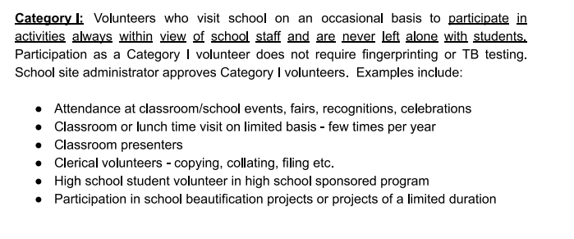
Volunteer Clearance
    All volunteers must be cleared through RCSD.

Slide 21
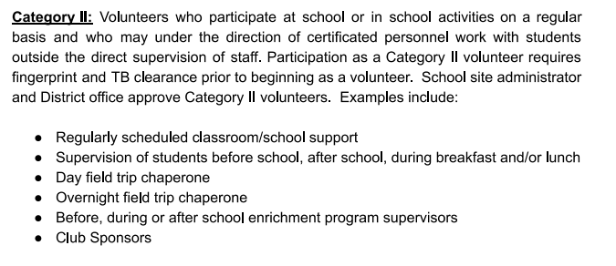
Volunteer Clearance
    All volunteers must be cleared through RCSD.

Slide 22

Announcements
Library Volunteers (Tuesday mornings)
Room Mom (class parties & carnival basket)
PTC Representative (4 meetings)
Co-Art Docent (once a month)
Handbook & Standards online
Complete Emergency Forms
PTC Forms & Spirit Wear
Be sure to sign-in ☺

Slide 23

Classroom Volunteer Positions
PTC Liaison
  Attend the 4 PTC Meetings this year (child care is provided)
  PTC Liaison Chair will send out the meeting minutes – forward those to your teacher and parents. Help keep them informed!
  Send out sign up geniuses to your class parents for our PTC fundraisers and events!
Room Parent
  Coordinate 3 parties (winter, valentines and end of year party)
  Assist with staff/teacher appreciation as needed
  Coordinate auction basket for Spring Carnival
Art Docent
  Lead art docent program in your student’s class
  Coordinate with your teacher on when to present the lesson to the class (monthly, bi-monthly, etc.)
  Attend training provided by PTC Art Docent Chair

Slide 24


Slide 25

Contact information
Kristen Benato
(916) 771-1880 ex: 42116
Email: kbenato@rcsdk8.org
Website: https://thefarmroom16.weebly.com/
Class
Website!

Slide 26

Now, it’s your turn…

